Slide 1
Project Presentation of Industry Oriented Hands on Experience (22CS422)
On
A Comparative Study of Swin Transformer and ResNet50 for Automated Detection of Age-Related Macular Degeneration Using Fundus Images
Avireet Kaur
2210990202
Supervised By
Dr. Shikha Tuteja
Department of Computer Science and Engineering,
Chitkara University, Punjab

Slide 2
TABLE OF CONTENT
INTRODUCTION
PROBLEM STATEMENT
ABOUT THE DATASET
ARCHITECTURES
METHODOLOGY
RESULTS
PERFORMANCE GRAPHS
CONCLUSION
FUTURE SCOPE

Slide 3
INTRODUCTION
What is AMD?
Age-related Macular Degeneration (AMD) – A progressive retinal disorder and one of the leading causes of irreversible central vision loss among older adults worldwide.
The condition primarily affects the macula, disrupting high-resolution visual functions such as reading, recognizing faces, and driving etc.
Manual review of fundus images is laborious and subjective as it is heavily dependent on clinical experience, leading to variable results and delayed diagnosis.
Artificial Intelligence and Deep Learning provide automated solutions for retinal disease detection and classification.
3

Slide 4
PROBLEM STATEMENT
Class Imbalance
Subtle Early Features
Limited Comparative Studies
ADAM dataset: only 89 AMD images vs 311 Non-AMD. Severe imbalance biases models towards the majority class, reducing AMD sensitivity.
Early-stage AMD shows minimal drusen deposits and subtle RPE changes
Extremely difficult to detect without high-resolution feature extraction.
Very few direct comparisons between CNN models (ResNet50) and modern Transformer architectures (Swin) exist specifically for AMD detection.
This study addresses these challenges by comparing ResNet50 and Swin Transformer with SMOTE-based balancing on the ADAM dataset.

Slide 5
ABOUT THE DATASET
ADAM DATASET
Total Images
400 color fundus images
AMD Class
89 images (minority)
Non-AMD Class
311 images (majority)
Image Size
Resized to 224 × 224 px
Normalization
ImageNet statistics
Format
2 folders by class label
To increase diversity in the samples, augmentation was applied to the existing images.
After augmentation, each set contained 1335 AMD images and 3110 Non-AMD images, with equal distribution in all three sets.

Slide 6
ARCHITECTURES
ResNet50
Swin Transformer
Convolutional Neural Network
Vision Transformer Architecture
50-layer deep residual network with skip connections
Hierarchical local feature extraction via convolutions
Pre-trained on ImageNet-1K, fine-tuned for AMD
Classification head replaced with binary linear layer
Computationally efficient on small datasets
Hierarchical shifted-window self-attention mechanism
Captures both local fine-grained and global features
Multi-scale feature extraction — computationally efficient
Pre-trained on ImageNet-1K, fine-tuned for AMD
Classification head replaced with binary linear layer

Slide 7
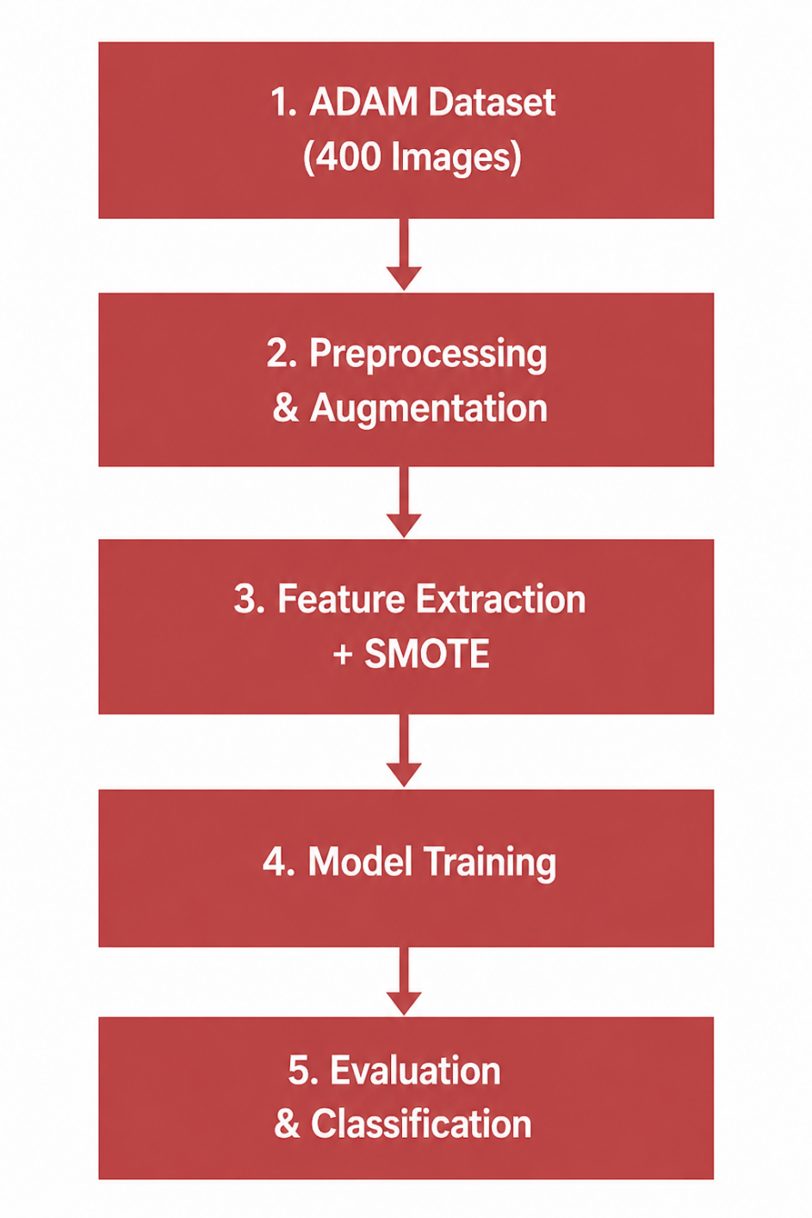
METHODOLOGY

Slide 8
RESULTS
Classification Performance After Fine-Tuning
Model | Accuracy | Precision (AMD) | Recall (AMD) | F1 (AMD) | Macro F1 | AUC
Swin Transformer | 88.68% | 0.81 | 0.82 | 0.81 | 0.87 | 0.919
ResNet50 | 84.00% | 0.74 | 0.71 | 0.72 | 0.80 | 0.855
Confusion Matrix Comparison
Model | True AMD | AMD → Non-AMD | True Non-AMD | Non-AMD → AMD
Swin Transformer | 1097 | 238 | 2845 | 265
ResNet50 | 950 | 385 ⚠ | 2761 | 339
Swin Transformer outperforms ResNet50 across all metrics.
Its hierarchical shifted-window self-attention captures both local and global retinal features
Superior AMD recall (0.82 vs 0.71) and significantly fewer false negatives (238 vs 385), which is clinically critical.

Slide 9
PERFORMANCE GRAPHS

Slide 10
CONCLUSION
Swin Transformer achieved superior AMD classification performance.
Transformer-based architectures captured retinal features more effectively.
ResNet50 Struggled with long-range dependencies and exhibited overfitting
ResNet50 showed limitations in handling global dependencies.

Slide 11
FUTURE SCOPE
Address class imbalance using techniques like SMOTE to improve sensitivity & reduce false negatives
Increase the volume and diversity of retinal images to significantly improve the generalization
Implement regularization techniques such as dropout, weight decay, and advanced learning rate scheduling to prevent overfitting and ensure model stability.
Integrate Explainable AI (XAI) like Grad-CAM, to provide transparent explanations
Move beyond binary classification to multi-class models capable of differentiating between forms of AMD

Slide 12
Thank You
12

